Slide 1
Helio-Tracker Scientific Inquiry
Grayson Call & Gavin Alexander
VMS - 8th Grade
March 2015

Slide 2
PROBLEM STATEMENT
Is it possible build a self-powered helio-tracker that replicates a sunflower’s ability to turn toward the sun?

Slide 3
ABSTRACT
Have you ever looked at the sun (indirectly, of course) and wondered about the applications of a star so near to us? Well if you have, has it ever made you think of sunflowers or solar power? Solar power technology is becoming more and more of interest nowadays due to the raised awareness of our destroying the Earth. Solar energy is an efficient way of harnessing the sun’s power to create energy. Unfortunately, solar power is also faced with the problem of not being as effective as it could be due to solar panels’ immobility. This raises the question: What if you could create a completely self-powered contraption that is designed to keep a solar panel constantly facing toward the sun to help it generate steady amounts of power? For this project, we intend to draw upon nature’s solution to this question: sunflowers. Sunflowers have ways of turning toward the sun before they start to bud. If we can replicate their ability to turn toward the sun using the chemical reactions and pressure resulting from alcohol’s evaporation, we may be able to make an efficient, self-powered solar generator that would have applications in third-world countries and remote areas such as forests. Even better, we intend to create our contraption using almost completely of cheap, common materials. This would mean that, if you should decide, you could build your own reproduction of our machine for your use and convenience.
As such, the purpose of this project is to create a self powered helio-tracker that turns toward the sun to get the maximum sunlight using everyday materials.

Slide 4
TEST HYPOTHESIS: Materials
Glass jars x4 (small)
Reynold’s wrap aluminum foil (1 box)
400 ml of 70% isopropyl rubbing alcohol
Folders (3)
Extendable shower rod
Cardboard/Cardboard boxes
PVC pipe (1.75” in diameter and 37”-39” in length)
Photovoltaic panel (solar panel)
Fish tank tubing (4 coils)
Wire hangers (3-4 packs of 10)
Steel saw
Electric drill w/ long drill bit (wireless)
Scissors
11” wooden rods (4)
Duct tape (2 rolls)
Balloons (1 bag)
Wire cutter
Pliers/Wrench
Wires
Zip-ties
Plastic Crate
Vegetable oil

Slide 5
TEST HYPOTHESIS: Procedure
Assemble all materials (see materials)
Straighten out around 30 wire hangers
Cut off the hooks and the corkscrew pieces of the straightened hangers
Intertwine two of the straightened hangers together (x4)
Drill shower rod at diagonal angles so they do not intersect with each other.
Slide the intertwined hangers through the holes that have just been drilled.
Bend wires so that it curves upward
Attach a wire between the intertwined wires and the shower rod to act as a strut to keep the wires from bending when under pressure
Pour 100 ml of 70% isopropyl rubbing alcohol into each glass jar
Cut off the bottom halves of 4 balloon
Stretch balloon halves over the tops (open end) of the glass jars and duct tape
Bend intertwined wires around the top of jars until they are safely secured and duct tape
Cut two hangers into halves and duct tape to top of shower rod to support platform
Cut wooden rod into 4 11 in. segments
Saw the PVC pipe into 4 segments
Cut 4 disks out of cardboard that fit snugly into the pipes
Hot glue one disk to one end of each of the four wooden rods
Slide the cardboard disk ends of the rods into an inside out balloon top (the end with no tube) and secure the balloon top with duct tape
Coat the interior of the pipes with Vegetable oil
Place rods w/disks into the pipe segments
Cut off the bottom halves (the ends with the tubular piece) of 4 balloons and stretch one of them over one end of each of the pipe segments, securing each balloon piece with duct tape
Insert one end of a coil of fish tank tubing into the tube piece of the balloon bottoms on the pistons and the other end of the tubing coil into the tube piece of the jar opposite that piston and secure with duct tape, repeat with each piston and its corresponding jar
Duct tape one straightened hanger to each coil tubing like you would a splint on an arm to straighten it out
Cut out 4 more disks with a hole in the middle of each big enough for the wooden rod to move freely to use as caps for the pipes,secure with duct tape
Duct tape the newly made pistons near the top of the shower rod
Attach the free end of the tubing to the balloon attached to the glass jars and duct tape them

Slide 6
TEST HYPOTHESIS: Procedure
27. Cut out a cardboard platform (rectangular in shape and thick enough to hold the panel’s weight)
28. Cut hole in cardboard and slide in the photovoltaic panel
29. Cut folders into halves at the fold in the middle
30. Cut folders halves into 4ths
31. Cut pieces of hangers
32. Bend hanger pieces along the back of the folder pieces to help support it and hold it’s shape
33. Cover one side of folder pieces with aluminum foil
34. Bend hangers into a circle
35. Duct tape two intersecting wire hanger pieces to the inside of the circle
36. Duct tape the intersecting wires to the intertwined wire under the glass jars
37. Duct tape 4 “pedals” (folder pieces) to the outside of the circle
38. Attach the pedals to the top of the glass jars using wire and duct taping it to the top of the jar and the top of the pedal to provide extra support
39. Place the shower rod next to the plastic crate
40. Thread the zip-ties through holes in the crate (drill some if needed) and tighten around the shower rod to help prevent tilting
41. Optional: Place counterweights into crate to stop the helio-tracker from tilting.

Slide 7
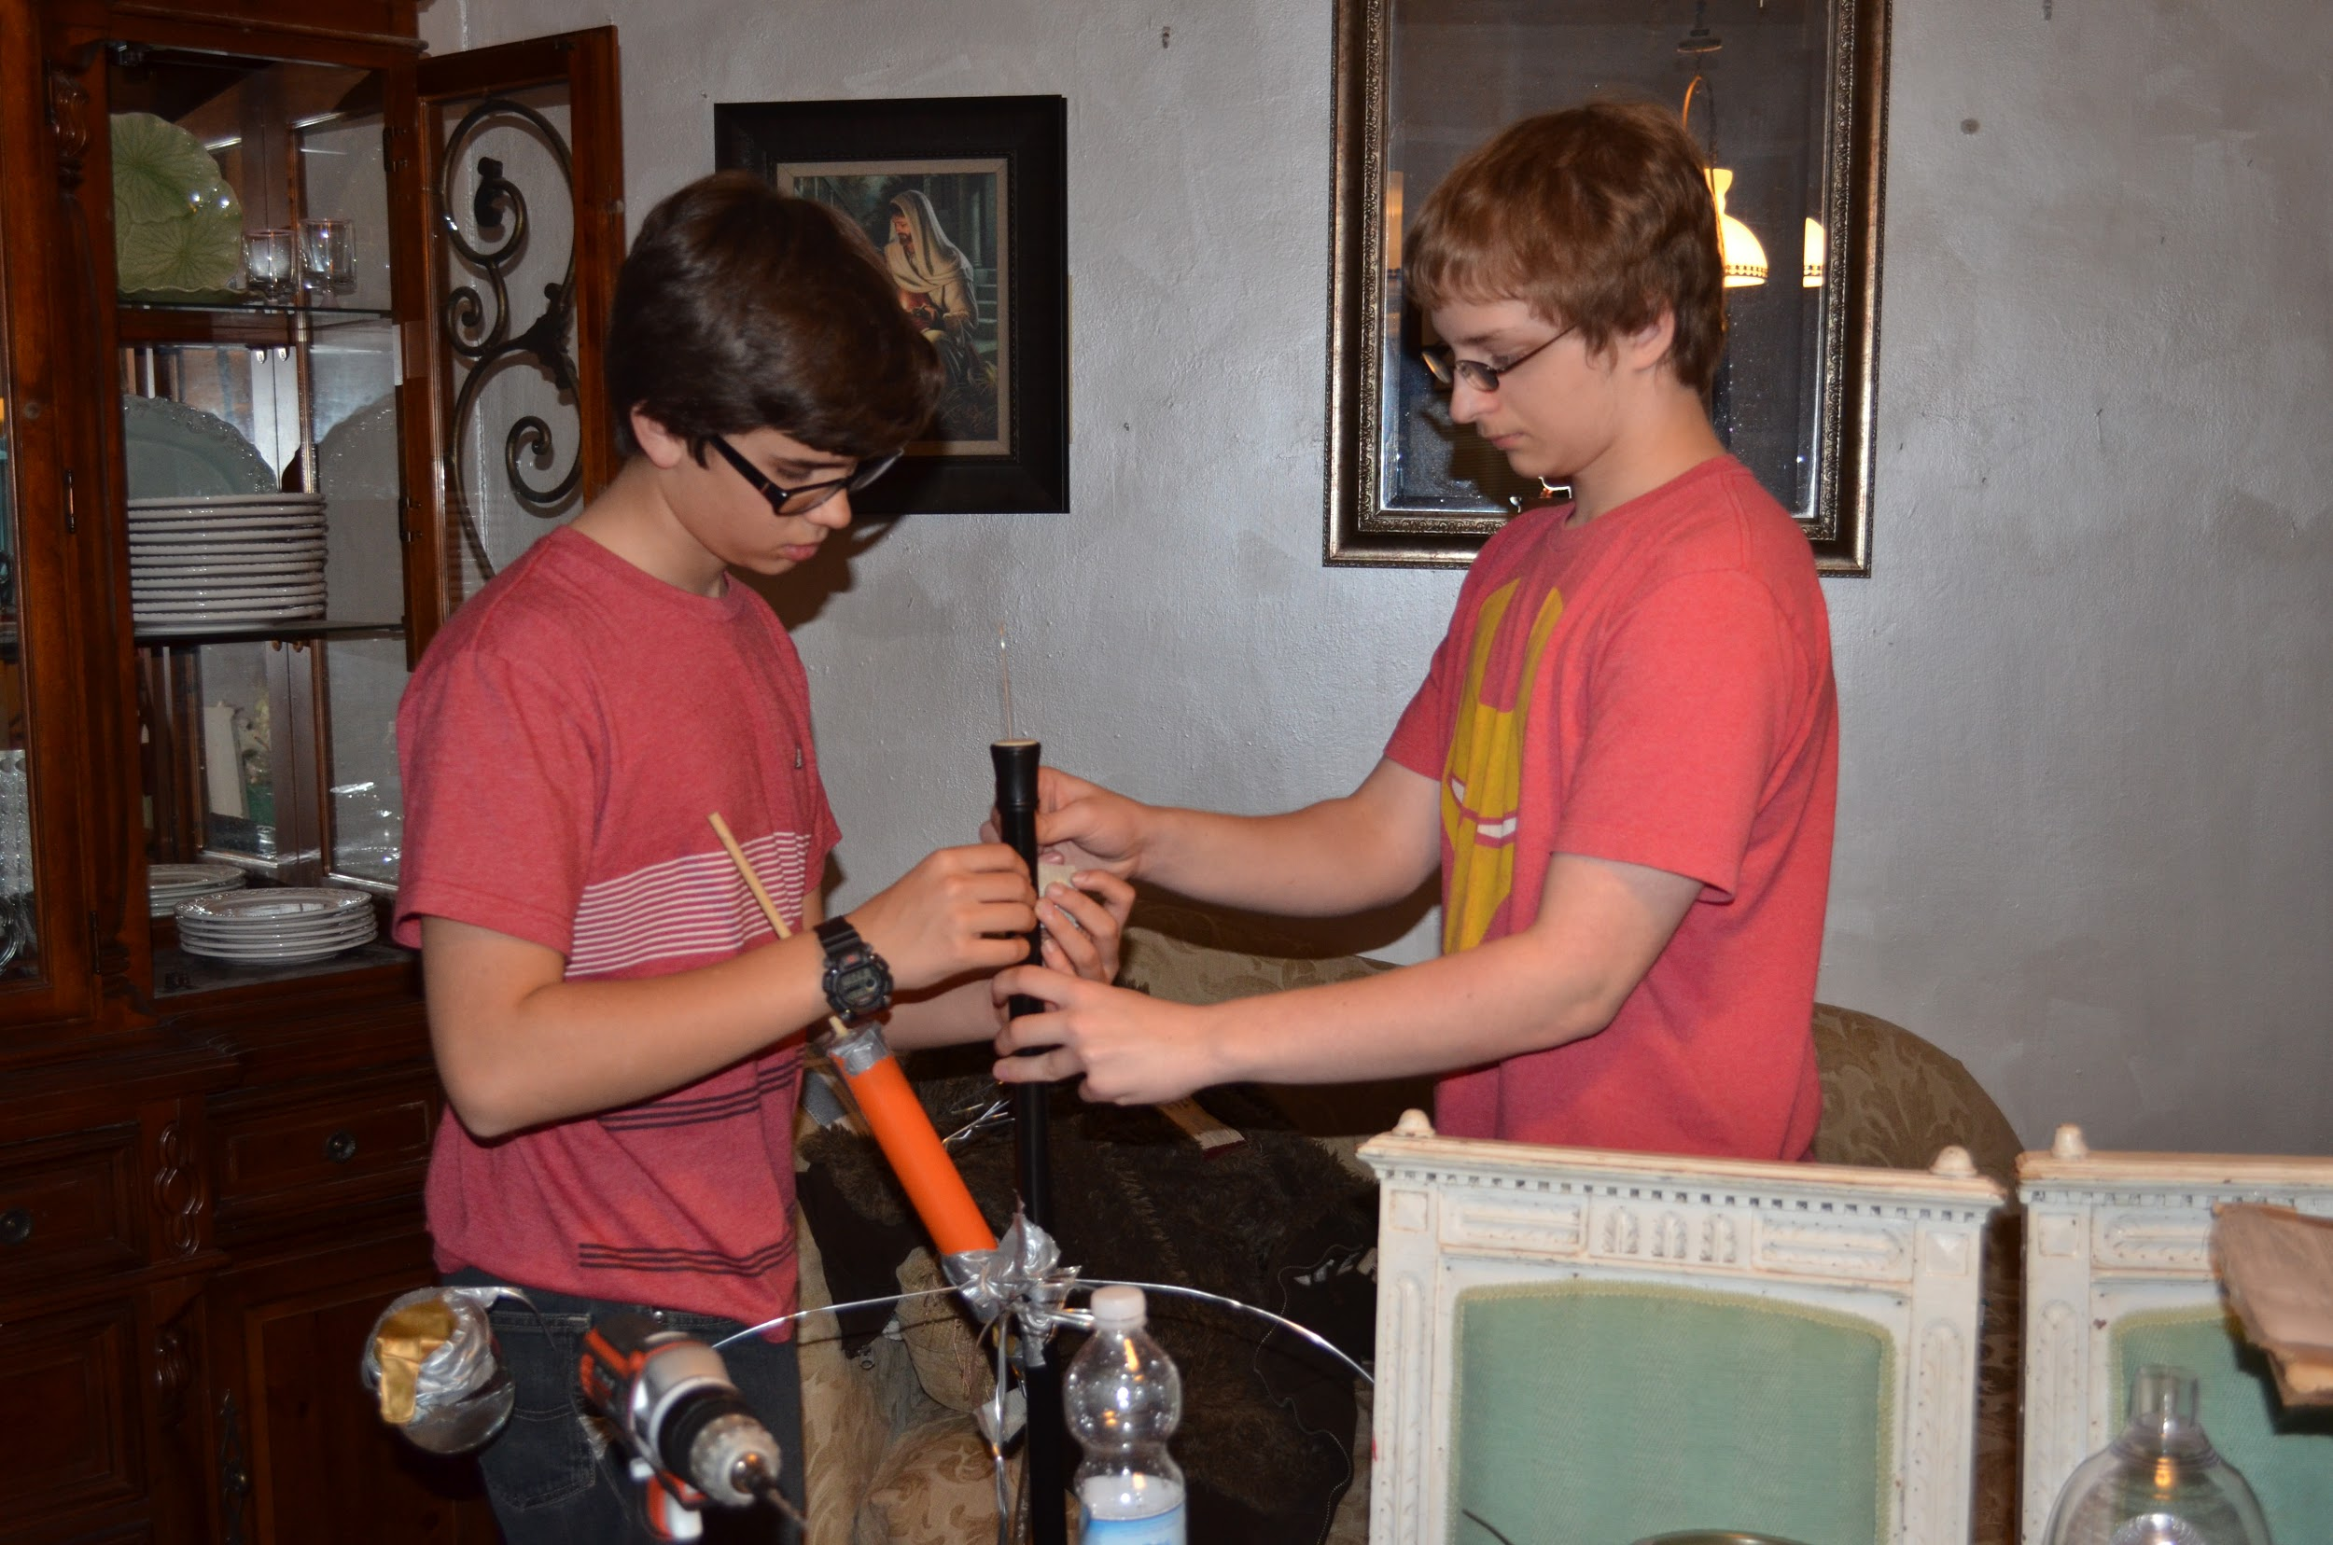
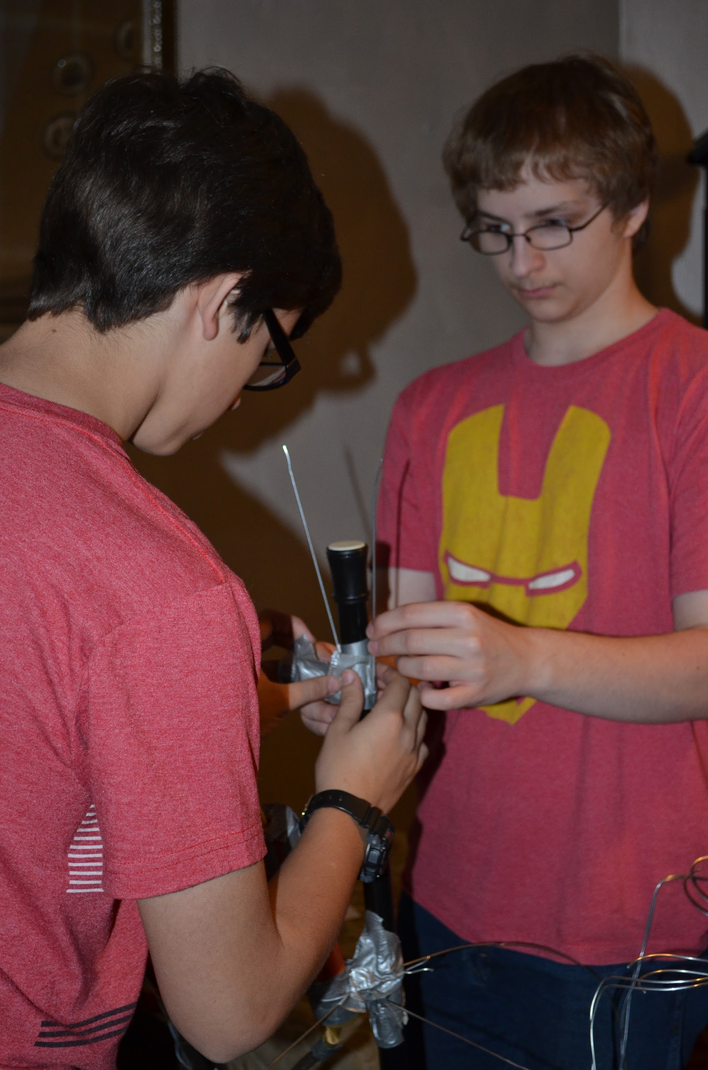
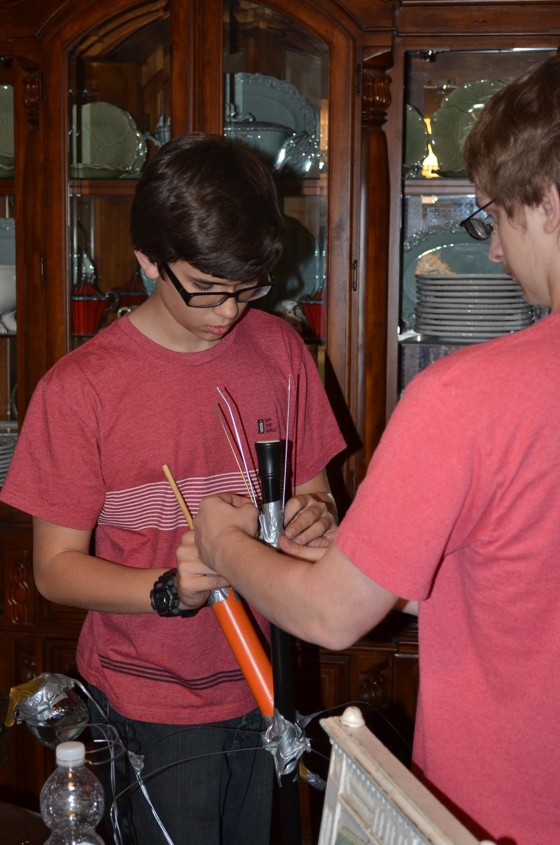
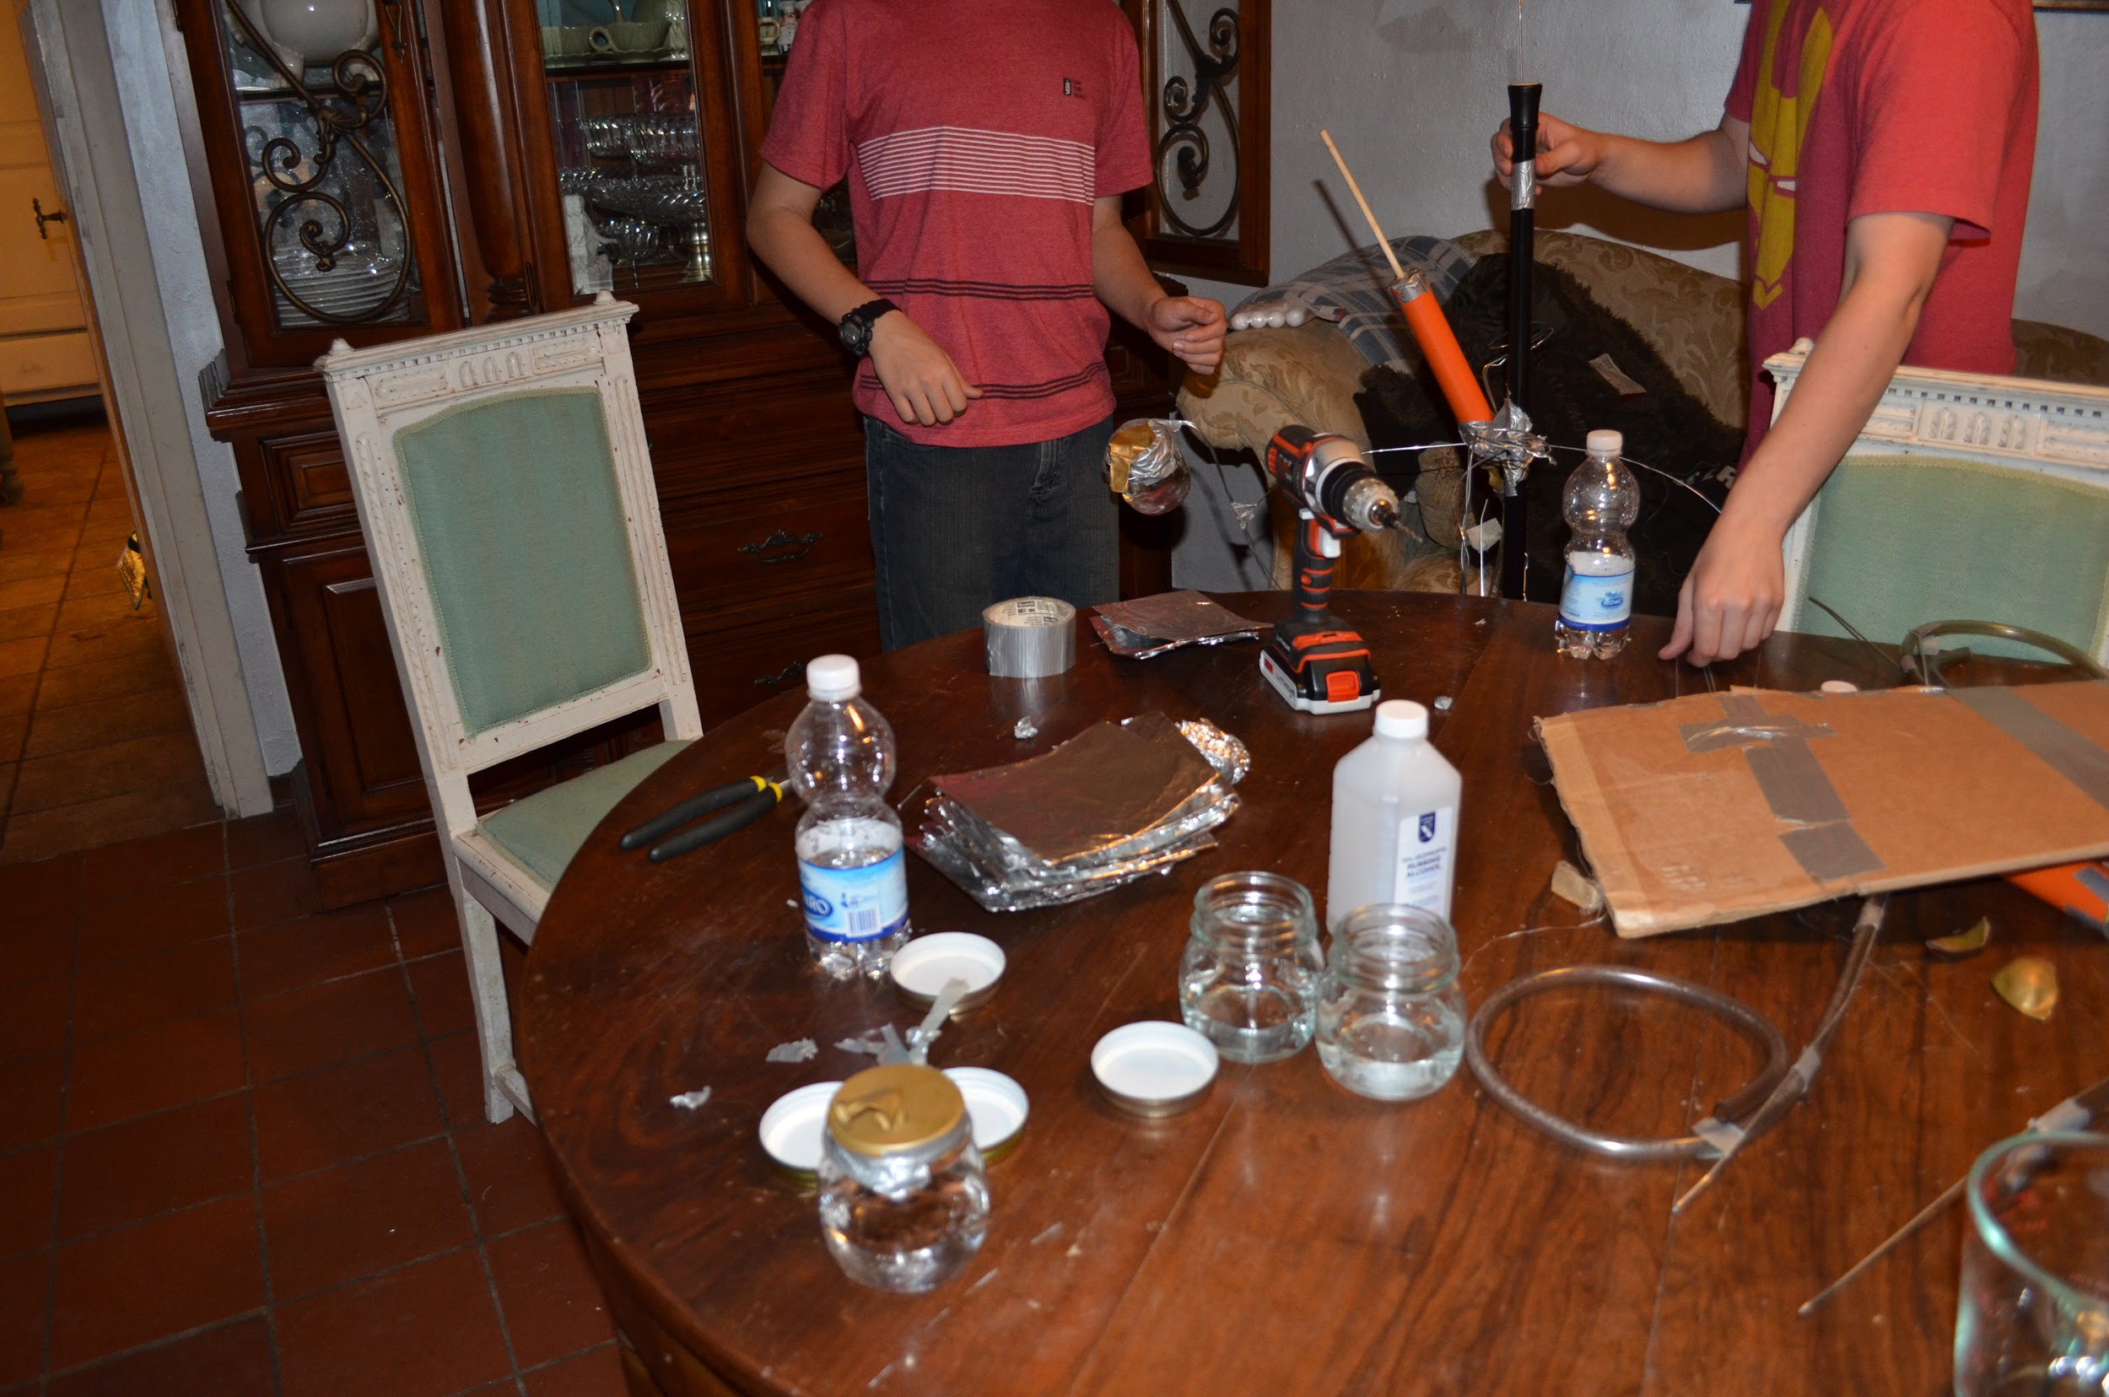

Slide 8
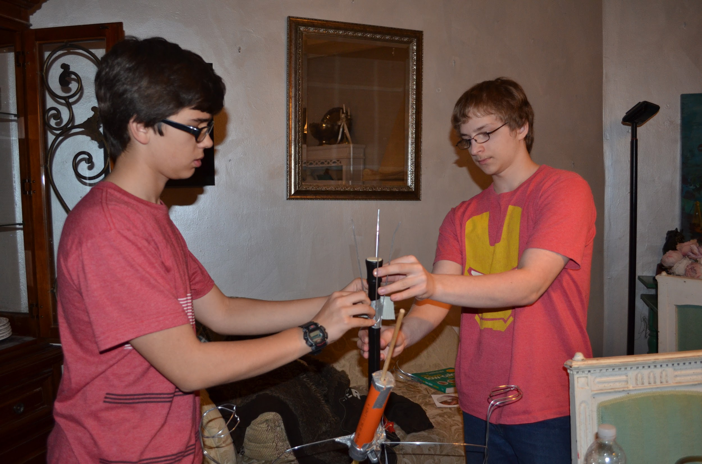
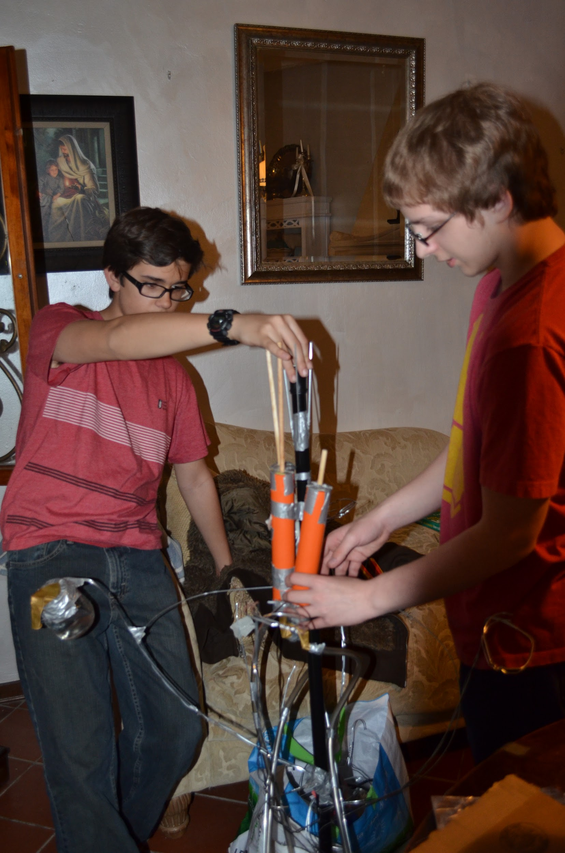
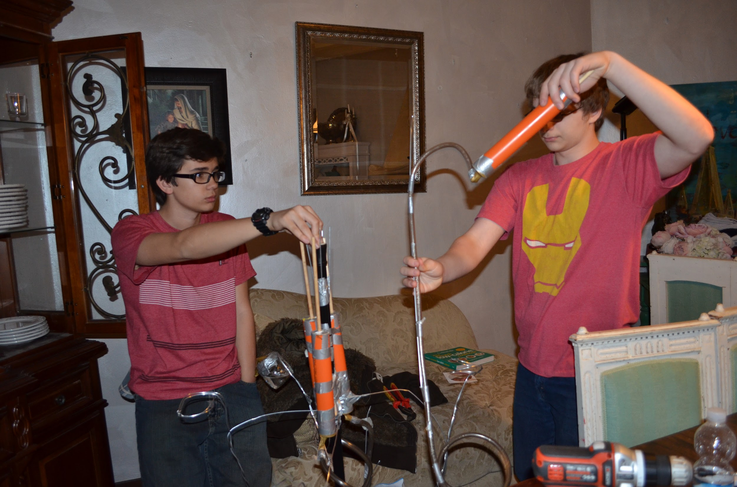
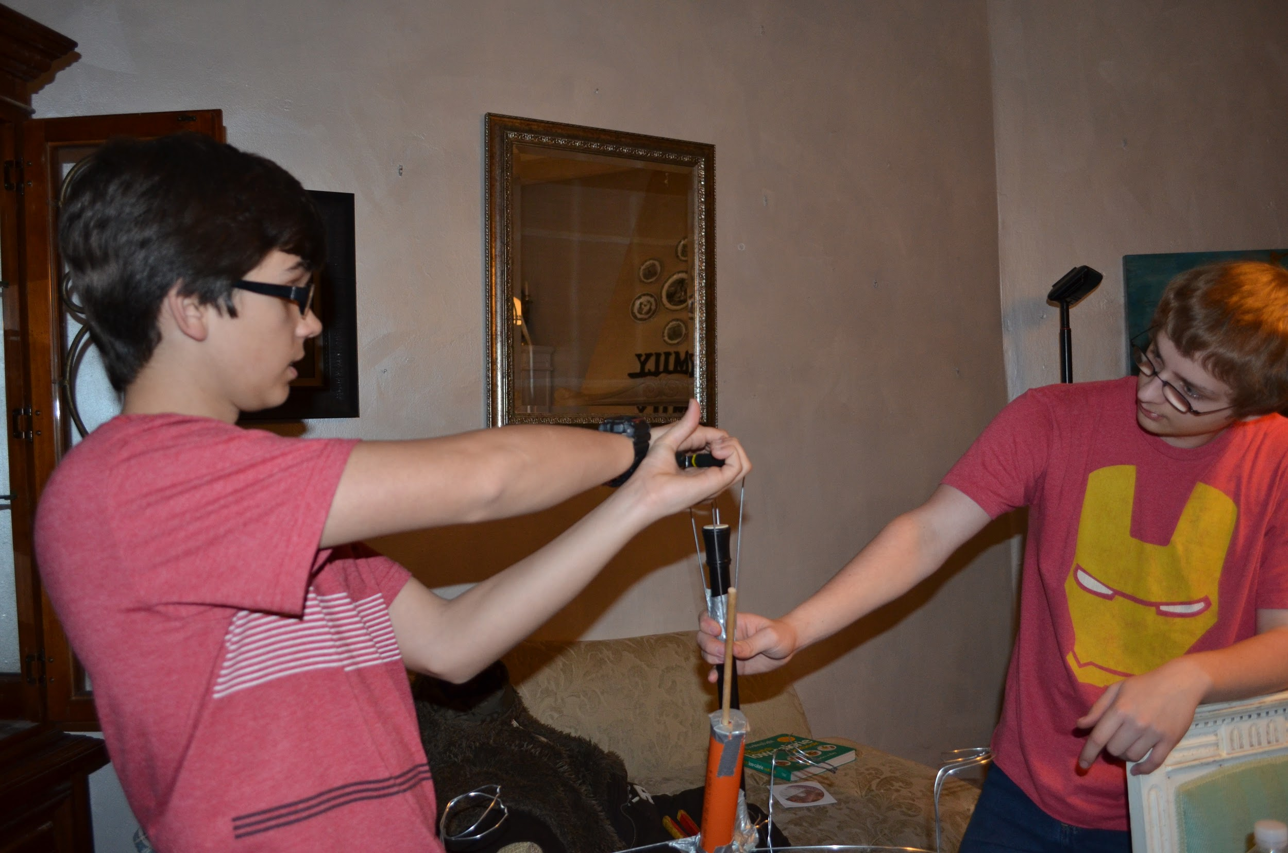
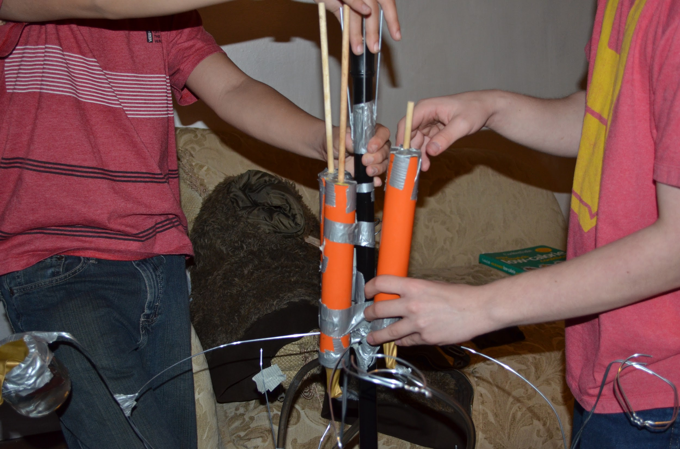

Slide 9
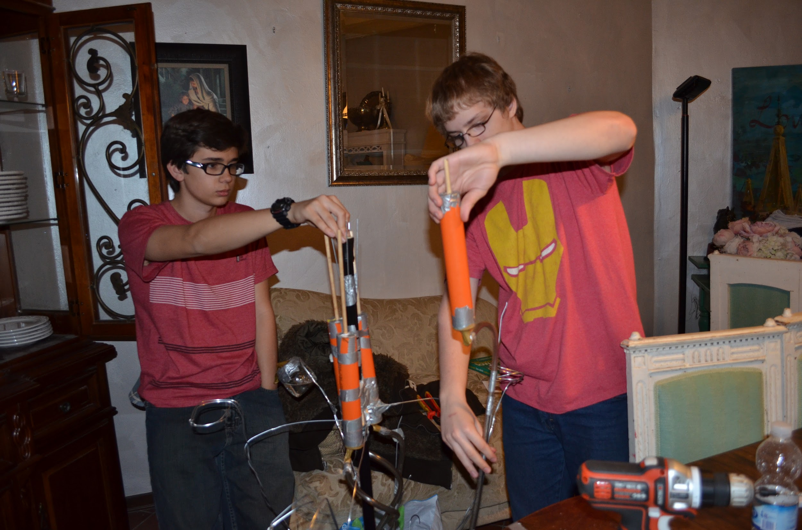

Slide 10
DATA
Qualitative:
When the helio-tracker was exposed to light, the “petals” reflected the light as planned but failed to reflect enough light and heat to produce enough of a change in the alcohol’s physical state to create much pressure, this having been proven when we held our hands near the petals and felt almost no heat. We also heard no evidence of leakages, ruling that factor out as a problem. As a result of this, we think there must not have been enough heat to cause the pressure needed from the alcohol’s evaporation to set the helio-tracker into motion.

Slide 11
CONCLUSIONS
Conclusion: Once constructed our helio-tracker was unresponsive to the light. There are many different things that could have caused this. Personally, we think it was due to the aluminum foil not being reflective enough, absorbing too much heat, or being too crinkly. We think this because the alcohol showed no signs of evaporation under the concentration of light from the foil. Additionally, we think it could have been due to a leakage in the balloons sealing the cylinders or jars or maybe the amount of direct light coming from the overcast sky.
Analysis: After each of our tests, the prototype consistently did not move on its own. If we were to do it again, we would try to find a reflective material that is not as crinkly as aluminum foil in order to have a better concentration of light and heat on the jars. Even if we made this change though, we would still be worried as to whether it would be enough to change the results and get the prototype working.
Evidence: When we checked each piece of the prototype, we detected no leakages, meaning that it most likely was not a problem with the balloons or tubing. When we checked the heat emitting from the foil, we found it to be insufficient. Based on those findings, we believe the problem to have lied with the foil. We are unsure, however, if changing the material it would do much though as we don’t know if it was entirely the foil’s fault or if it was partially due to the sun’s light on the day we tested.

Slide 12
Bibliography
Science Buddies Staff. "Build Your Own Helio Tracker—a Self-powered Mechanical Sunflower that Turns with the Sun" Science Buddies. Science Buddies, 2 Sep. 2014. Web. 23 Feb. 2015 <http://www.sciencebuddies.org/science-fair-projects/project_ideas/ApMech_p045.shtml>
Unknown, Unknown. "Phototropism - Corn." Phototropism - Corn. Unknown, n.d. Web. 22 Mar. 2015. <http://plantsinmotion.bio.indiana.edu/plantmotion/movements/tropism/solartrack/solartrack.html>.
Google. “Define+pistons - Cerca Con Google.” Define+pistons - Cerca Con Google. Google, n.d. Web. 22 Mar. 2015. <https://www.google.it/search?q=define+pistons&oq=define+pistons&aqs=chrome..69i57.4258j0j9&sourceid=chrome&es_sm=0&ie=UTF-8>
Ota, Jonathan. "CALIFORNIA STATE SCIENCE FAIR 2009 PROJECT SUMMARY- Helio-Tracker." (n.d.): n. pag. 2 Apr. 2009. Web. 22 Mar. 2015. <https://www.usc.edu/CSSF/History/2009/Projects/S0217.pdf>.

