Slide 1
STEM PROJECT
Science Inquiry
Sample from Science Buddies
VMS - 8th Grade
March 2015

Slide 2
ABSTRACT
Have you ever seen a product labeled "biodegradable" or "compostable" and wondered just how well it decomposes? A lot of different products claim to be biodegradable or compostable, such as food containers, bags, packaging materials, and spoons and forks. Not only do they clearly come in different shapes and sizes, but they are made of different materials as well. Do they decompose differently, and, if so, which decomposes the fastest? In this Environmental Science project, I made an indoor composter and investigated the rate in which different biodegradable and compostable items decompose.
The purpose of this project is to make an indoor composter and determine how readily different materials decompose.

Slide 3
PROBLEM STATEMENT
Disappearing Act:
Do Different Biodegradable & Compostable Materials Decompose at Different Rates?

Slide 4
BENEFIT TO COMMUNITY or
REAL-WORLD APPLICATION
Composting is a great way to recycle material that may otherwise be thrown into a landfill and take years to decompose. Composting is the process of converting some of the “waste” we produce, such as spoiled food, rotten fruits and vegetables, or yard trimmings and lawn cuttings, into compost. The result is decomposed materials that can be used to feed, or fertilize, or fertilize plants. Compost is rich in nutrients that plants readily devour.
One material that cannot be composted and frequently finds its way into landfills is plastic. Many everyday items, such as grocery bags, food containers, packaging materials, and disposable forks and plates, are made of plastic (usually polyethylene or polystyrene). It is estimated that plastic takes hundreds of years to decompose. Consequently, researcher are developing new products that decompose more quickly and can be used instead of plastic products. Some of these new products claim to be “biodegradable” or “compostable”. But what does this translate into terms of how well they decompose and turn into compost?
DID YOU KNOW???
An ongoing study by Stanford engineers, in collaboration with researchers in China, shows that common mealworms can safely biodegrade various types of plastic.

Slide 5
HYPOTHESIS
If biodegradable and compostable materials are placed in a compost bin, then they will decompose at different rates based on their composition.

Slide 6
TEST HYPOTHESIS: Materials
Compostable or biodegradable products to test (at least 3). Use products made of different materials so that you can compare how well the different materials decompose. Here are some products you could test: Compostable bowls (made out of bagasse), Compostable cutlery (made of starch), SunChips® bags (made of PLA), natural and organic foods, such as Whole Foods Market®
Ruler, Scissors, Tape, Permanent Marker
Blank paper or white paper towels
Camera
Digital scale with 0.1 gram (g) increments, Digital thermometer (optional), Humidity gauge (optional)
String or yarn made out of synthetic fibers, such as polyester or acrylic (at least 7 meters)
Plastic bin with a lid that seals, at least 10 gallons in size, Tray for under the bin; A second lid may work for this, Buckets (optional)
Drill with bits that are ideally 3/8 inch or ¼ inch
Two wooden boards, 3/4 x 1½ inches. The boards should be cut the same length as the plastic bin. Some hardware stores will cut the wood for you.
Green composting materials
Brown composting materials, see Table 1 below (enough to fill the bin at least half full to start with, and a small continual supply to continue filling the bin over time)
Soil not treated with chemicals or organic potting soil (enough to fill the bin at least 6 centimeters [cm] deep)
Compost aerator or long rubber gloves.

Slide 7
TEST HYPOTHESIS: Procedure
Preparing the Biodegradable or Compostable Items
Before setting up your compost bin, you will want to make sure your biodegradable or compostable products are ready for testing.
Lay your different test products out. How are they similar to each other, and how are they different? Are some thicker or longer than others? Record observations.
Cut your products up into squares that are each about 10 cm long. Because the size of something can affect how quickly it decomposes, try to make your items as similar in size as possible.
In this way, prepare three different test items from each product. For example, if you are testing three products, you should make a total of nine test items. Testing multiple items made from each product will help you ensure that your results are accurate and reproducible.
Record data on what the test items look like now. This will help you see how they change after you compost them and assess which product decomposed the most. Create a table to record this data.
Lay your different items out on some blank paper or white paper towels.
Assign each item a number and write it on the paper next to the item. Write down which item was assigned which number in your lab notebook, including the product each item came from.
Take a picture of all your items with their numbers written next to them. You can take extra pictures of individual items, too.
Using the digital scale, weigh each item separately and record the weight in your lab notebook. If any item does not weigh enough to register on your scale (i.e., the scale says "0.0 g"), then make a larger test item out of the same product to replace the smaller test item. Ideally, you want to use items that weigh at least 1.5 g. When something decomposes, it loses weight. By determining how much weight each item loses, you will have an idea of how much each item decomposed.

Slide 8
TEST HYPOTHESIS: Procedure
Preparing the Biodegradable or Compostable Items
6. Attach permanent labels to your test items so you can easily find and identify them later
7. For each test item, cut a piece of string that is about twice as long as the height of the bin.
Tightly tie the string to each test item. Make sure the string is securely attached.
You may need to cut a slit in the item to tie a string securely to it. Do not actually cut out a hole because this will change the item's weight.
To the free end of each string, fold a small piece of tape over on itself. Then use the permanent marker to write the number of the test item the string is attached to on the tape.
Make sure the tape label is securely attached to the string.

Slide 9
TEST HYPOTHESIS: Procedure
Setting Up the Compost Bin
In this part of the science project, you will build the compost bin and start the composting process.
First you will ready your plastic bin for composting.
On the bottom of the plastic bin, drill ten to 12 holes roughly evenly spaced from each other. You may want to ask an adult to help you do this. Ideally, you will use a 3/8 inch or 1/4 inch drill bit.
Find a place indoors that is out of the way where you can keep your compost bin for several weeks. It should not be in a place that receives a lot of direct sunlight, because this may dry out the compost. After you fill the compost bin, it will be heavy, so you will not want to move it.
In the area you picked to set up your compost bin, place the tray (or extra bin lid). Inside the tray, space the two wooden boards evenly across it. The boards will help raise your bin up so that air flows easier through the holes in the bottom.
On top of the boards, place your bin so that it is stable. Your setup should now look like the diagram in Figure 2.

Slide 10
TEST HYPOTHESIS: Procedure
Setting Up the Compost Bin
2. Next collect and prepare the materials you will use for composting. When making compost, the materials that are added are usually green or
brown materials, as listed in Table 1. Several materials, also listed in Table 1, should not be used in an indoor compost.
3. Collect enough scraps to entirely fill your compost bin.
Using buckets is a good way to collect and sort your scraps.
You will need slightly more brown scraps than green scraps.
Because the scraps get compressed as you add more to the bin, you will actually need a lot more scraps than what you would need to simply fill the space inside the bin, so collect many more scraps than you think you will need.
4. Record what kind of green and brown scraps you collected. You can observe how well these different scraps decompose in your compost bin
over time. Shred all of the scraps so that none are longer than 5 cm. You can use the scissors very carefully to do this.
5. Add layers of green and brown scraps to the bin. Fill your bin with scraps all at the same time, or you can add them over several days. Just
make sure that when you add the biodegradable and compostable test items, you add them all at the same time.
6. Make a layer of brown scraps at the bottom of the bin. This layer should be about 7.5 cm deep.
FOR THE REST OF THE PROCEDURE, GO TO: http://www.sciencebuddies.org/science-fair-projects/project_ideas/EnvSci_p058.shtml#procedure

Slide 11
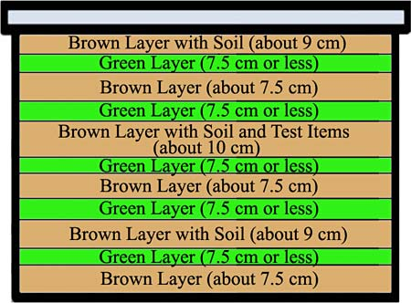
TEST HYPOTHESIS: Procedure
Setting Up the Compost Bin
Figure. Fill the compost bin by alternating between green and brown layers. Mix in a layer about 1.5 cm deep of soil into every other brown layer. When you have filled the bin about halfway, add the test items to a brown layer. Filling your bin may take several more layers than depicted in this figure.

Slide 12
TEST HYPOTHESIS: Procedure
To conduct this experiment, use following procedure:
1.
2.
3.
4.
5.
For a more detailed description of the procedure, click on the following link:
Do Different Biodegradable & Compostable Materials Decompose at Different Rates?

Slide 13
TEST HYPOTHESIS: Variables
MANIPULATED/INDEPENDENT VARIABLE (What is changed/what is tested):
Different Biodegradable & Compostable Materials
RESPONDING/DEPENDENT VARIABLE (What is measured):
Rate in which Materials Decompose
CONTROL/CONSTANTS (What is kept the same or controlled, so it is a “fair test”):
Compost bin
Soil
Temperature & Humidity

Slide 14
DATA
COMPOST LAYERS | Qualitative Observations | Days to Decompose | Temp & Humidity
Layer 1 (9 cm deep)
Layer 2 (7.5 cm or less)
Layer 3
Layer 4
Layer 5
Layer 6
Layer 7
Layer 8
Layer 9
Layer 10

Slide 15
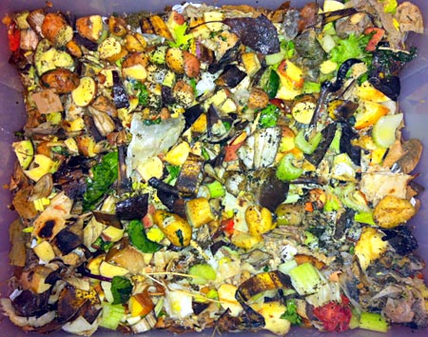
DATA
Photo of compost bin (top layer)

Slide 16
DATA
Fruit and Vegetable Decomposition, Time-lapse video

Slide 17
CONCLUSIONS
The data supported the hypothesis. The biodegradable and compostable materials did decompose at different rates based on their composition. It took ---- days for the natural and organic foods to decompose in a temperature of ---- and a humidity of -----. The compostable bowls (made out of bagasse) took -----days to decompose and the compostable cutlery (made of starch).
The plastic materials took ---- days longer than the natural materials to compose. Plastic is made from polyethylene or polystyrene). It is estimated that plastic takes hundreds of years to decompose. Consequently, researchers are developing new products that decompose more quickly and can be used instead of plastic products. Some of these new products claim to be "biodegradable" or "compostable." However, as I discovered in my experiment, these “biodegradable” materials still took a long time to decompose.

Slide 18
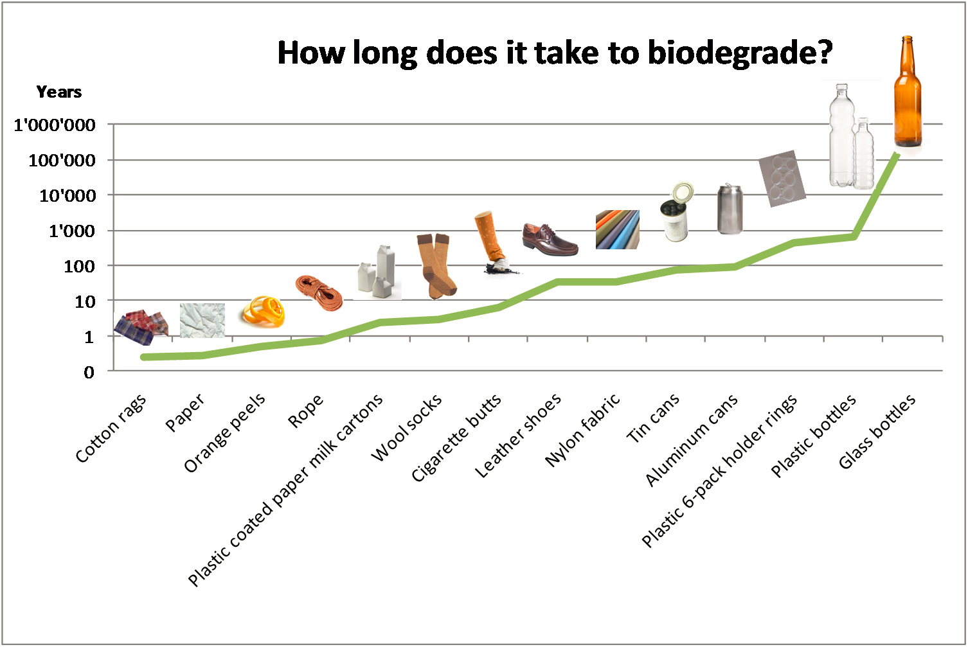
CONCLUSIONS

Slide 19
Bibliography
"Composting Indoors." : Journey to Forever Organic Garden. Keith Addison, n.d. Web. 03 Feb. 2016.
Jordan, Rob. "Plastic-eating Worms May Offer Solution to Mounting Waste, Stanford Researchers Discover." Stanford New, 29 Sept. 2015.
Web. 3 Feb. 2016.
"Research Areas." Multimedia Gallery. National Science Foundation, n.d. Web. 03 Feb. 2016.
Science Buddies Staff. "Disappearing Act: How Fast Do Different Biodegradable & Compostable Materials Decompose?" Science Buddies, 27 Oct. 2014. Web. 3 Feb. 2016 <http://www.sciencebuddies.org/science-fair-projects/project_ideas/EnvSci_p058.shtml>
Starkey, Sarah. "How To Make Your Own Indoor Compost Bin." Apartment Therapy. N.p., n.d. Web. 03 Feb. 2016.
"Compost How to Make Hot & Cold Piles." GrowingAnything.com. N.p., n.d. Web. 03 Feb. 2016.
The U.S. Government Printing Office (GPO). (2013, Sept. 18). Part 260 - Guides for the use of environmental marketing claims. Retrieved September 20, 2013.

